Slide 1

Introduksjon til Semantisk web-teknologi
TVA4410 Digitalisering av ingeniørfaglige prosesser
Knut Jetlund, NTNU i Gjøvik
knut.jetlund@ntnu.no
Mai 2022

Slide 2
Hensikt
Etter å ha gjennomgått fagstoffet skal du kunne
forstå konseptene for Semantisk web-teknologi
forstå hvorfor dette er relevant for byggeprosesser

Slide 3
Litteraturhenvisninger
RDF 1.1 Primer (w3.org) - https://www.w3.org/TR/rdf11-primer/
RDF Primer — Turtle version (w3.org) - https://www.w3.org/2007/02/turtle/primer/
Costin, A. and P. Pauwels (2022). Building information modeling and ontologies: overview of shared representations. Research Companion to Building Information Modeling. - https://www.elgaronline.com/view/edcoll/9781839105517/9781839105517.00010.xml
Luiten, B., et al. (2017). INTERLINK D4. Principles for a European Road OTL. Brussels, Belgium. – kap.6 - https://www.roadotl.eu/news/interlink-d4-principles-for-a-european-road-otl/
Forelesningsnotater

Slide 4
Den semantiske webben
Maskintolkbar informasjon kobla sammen på en standardisert måte
Unike og persistente identer
Informasjon og modeller i grafer
Costin, A. and P. Pauwels (2022). Building information modeling and ontologies: overview of shared representations. Research Companion to Building Information Modeling.

Slide 5
Den semantiske webben
Hvorfor er dette relevant for byggeprosjekter?
ekstremt fleksibel teknologi for modellering og kobling av informasjon
felles struktur for å tolke og akkumulere informasjon fra ulike kilder
standardisert teknologi fra World Wide Web Consortium (W3C) og ISO
kan avlede ny kunnskap basert på koblinger
Maskinlæring!

Slide 6
Costin, A. and P. Pauwels (2022). Building information modeling and ontologies: overview of shared representations. Research Companion to Building Information Modeling.

Slide 7
Fra filutveksling til lenkede data
© Mats Holter Rasmussen

Slide 8
© Mats Holter Rasmussen

Slide 9
DIKW - Data, Information, Knowledge and Wisdom

Slide 10
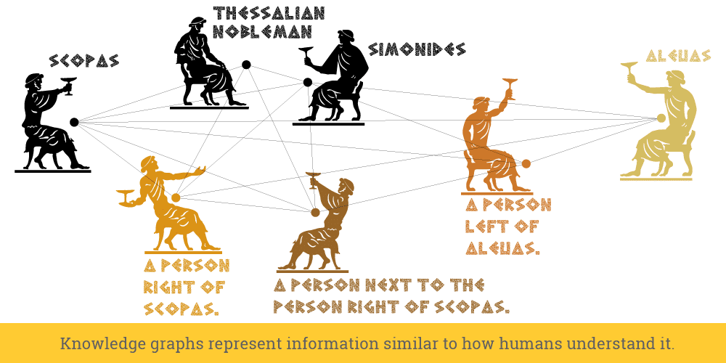
Kunnskap som graf – The Memory Palace
https://www.ontotext.com/blog/knowledge-graph-memory-palace/

Slide 11
Informasjonsmodellering
Universe of discourse – interessant del av virkeligheten
Kontekst – i hvilken sammenheng

Slide 12
Costin, A. and P. Pauwels (2022). Building information modeling and ontologies: overview of shared representations. Research Companion to Building Information Modeling.

Slide 13
Costin, A. and P. Pauwels (2022). Building information modeling and ontologies: overview of shared representations. Research Companion to Building Information Modeling.

Slide 14
Costin, A. and P. Pauwels (2022). Building information modeling and ontologies: overview of shared representations. Research Companion to Building Information Modeling.

Slide 15


Konseptuelle skjemaspråk
EXPRESS

Slide 16
Informasjonsmodeller og ontologier
Information model
“… a formal description of types of ideas, facts and processes which together form a model of a portion of interest of the real world and which provides an explicit set of interpretation rules.” (Schenck and Wilson, 1994).
“… a representation of concepts, relationships, constraints, rules, and operations to specify data semantics for a chosen domain of discourse” (Zhao et al., 2011)
≈ Ontology
“… a set of precise descriptive statements about some part of the world (usually referred to as the domain of interest or the subject matter of the ontology)” (Hitzler et al., 2012)
“… a common vocabulary for researchers who need to share information in a domain. It includes machine-interpretable definitions of basic concepts in the domain and relations among them”. (Noy and McGuinness, 2001)
Vocabulary
“terminological dictionary that contains designations and definitions from one or more domains or subjects”.
Regler for å forstå data i en kontekst
Implementerer konseptene i et modelleringsspråk
Definerer konseptene

Slide 17
Costin, A. and P. Pauwels (2022). Building information modeling and ontologies: overview of shared representations. Research Companion to Building Information Modeling.

Slide 19
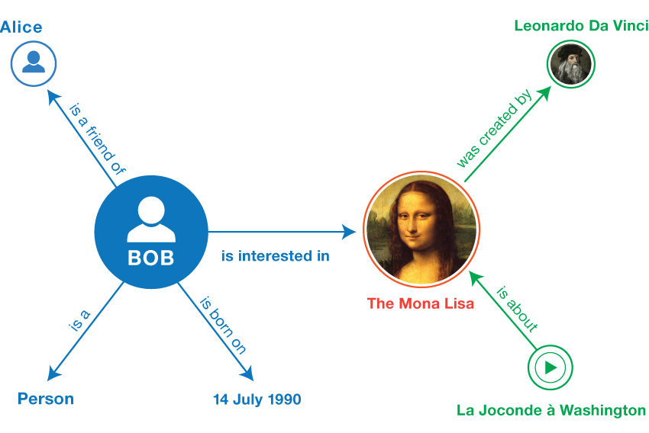
Manola, F., et al. (2014). "RDF 1.1 Primer." W3C Working Group Note. Retrieved 10 January 2021, from https://www.w3.org/TR/rdf11-primer/.

Slide 20
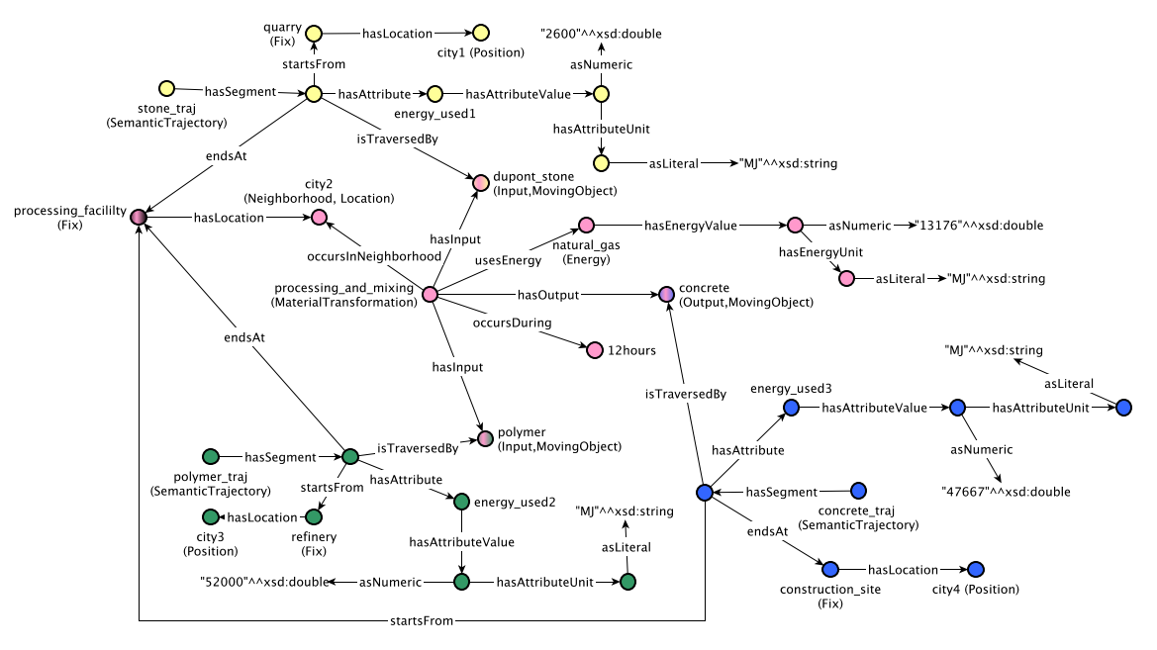
Vardeman, I., et al. (2017). "An Ontology Design Pattern and its use case for modeling material transformation." Semantic Web 8(5): 719-731.

Slide 21
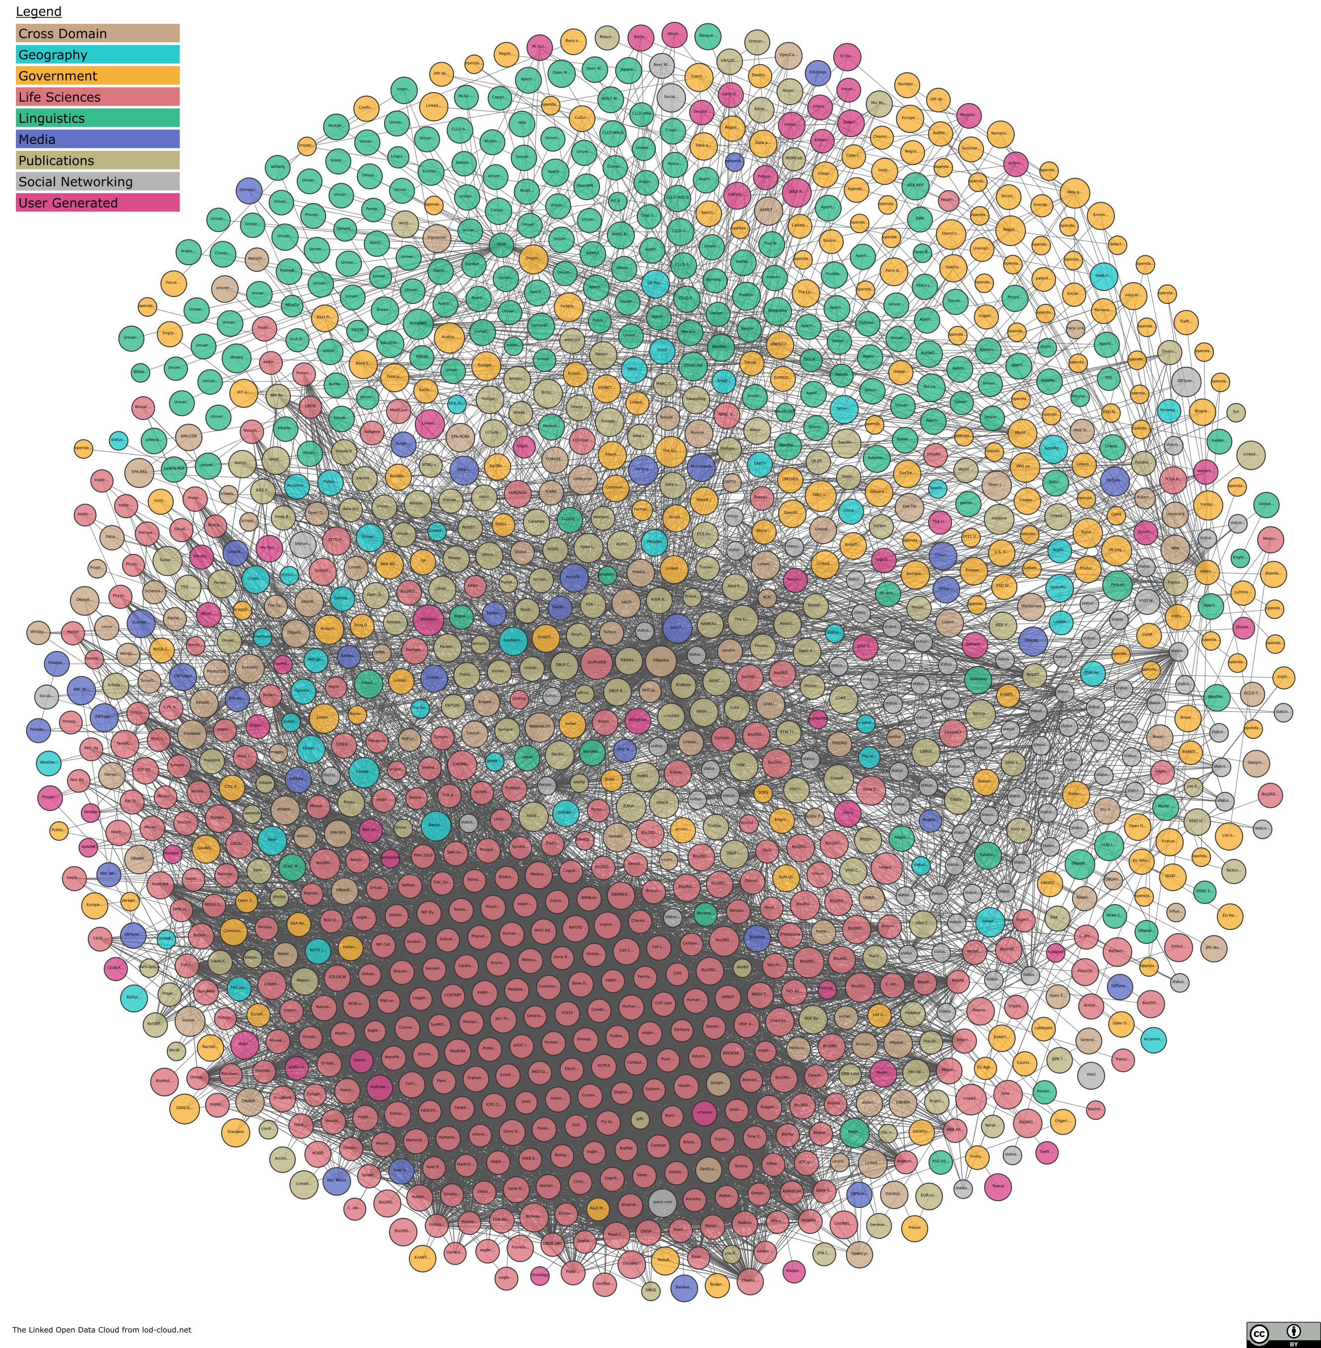
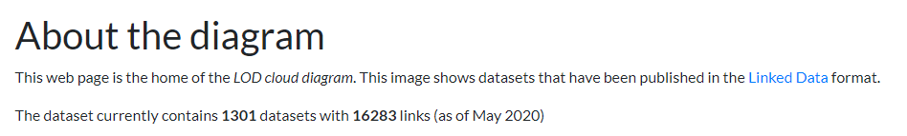
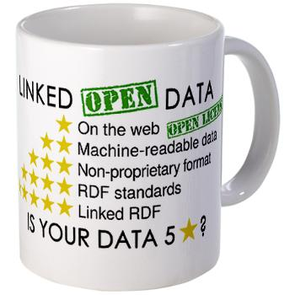
https://lod-cloud.net/

Slide 24
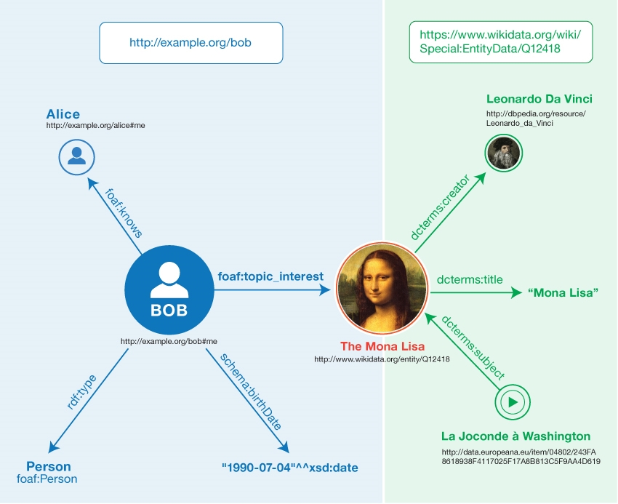
Manola, F., et al. (2014). "RDF 1.1 Primer." W3C Working Group Note. Retrieved 10 January 2021, from https://www.w3.org/TR/rdf11-primer/.

Slide 25

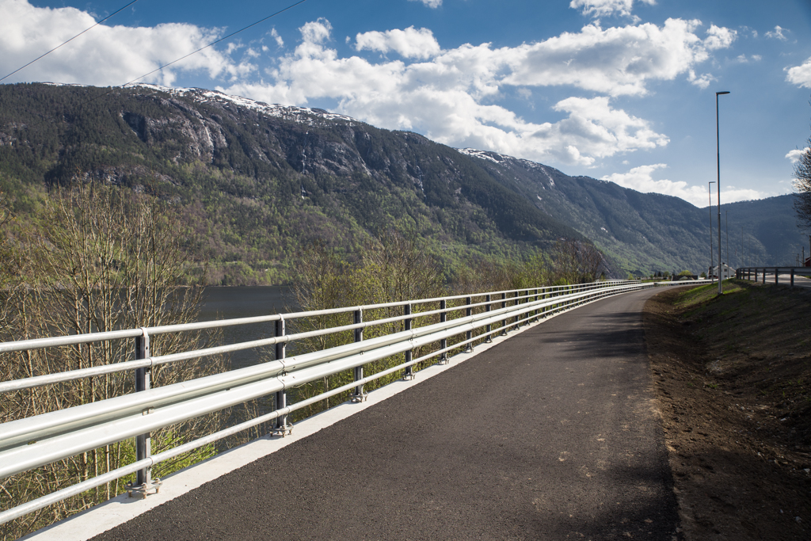
Hvordan klassifiseres virkeligheten?
Dette digitale objektet representerer et fenomen av klassen Rekkverk og kun det.
Objekter i denne klassen skal ha disse egenskapene, med disse tillatte verdiene…
Dette andre digitale objektet representerer et fenomen av klassen Gjerde
Objekter i denne klassen skal ha disse egenskapene, med disse tillatte verdiene…
Denne tingen fra virkeligheten er av klassene Rekkverk, Gjerde og Autovern
Det kan ha noen av disse egenskapene, men også andre
EXPRESS
Foto: Silje Drevdal / Statens vegvesen

Slide 26
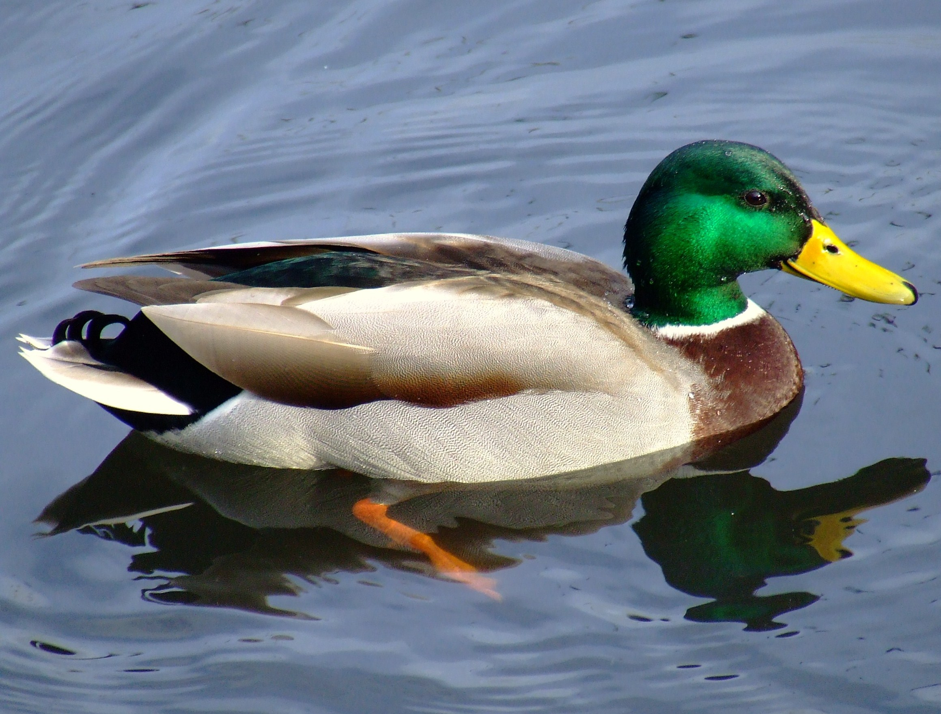
Hva er en and?
Tradisjonell modellering
Denne tingen er en and
Den har disse egenskapene:
Description logic
it looks like a duck, swims like a duck, and quacks like a duck
it probably is a duck. But not for sure
EXPRESS
https://en.wikipedia.org/wiki/Duck_test

Slide 27
Åpent og lukka syn på verden
Closed World Assumption (CWA)
The information model is complete in the given context
Additional or deviating information is invalid
Open World Assumption (OWA)
The information model presents only what is currently known in the given context
Additional information extends the model
EXPRESS

Slide 37
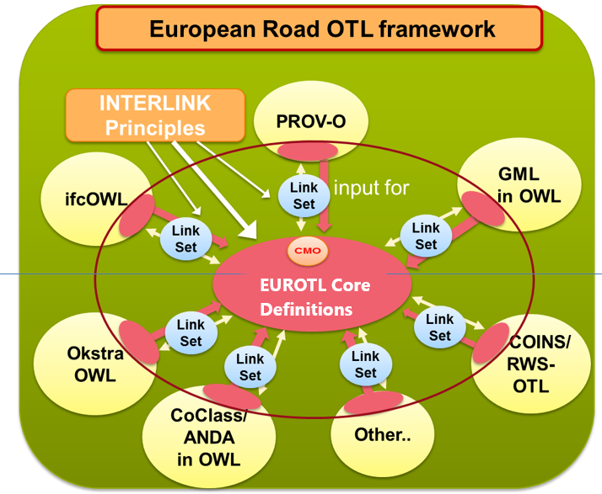
Linking and mapping information models and information
Luiten, B., et al. (2017). INTERLINK D4. Principles for a European Road OTL. Brussels, Belgium.

Slide 38
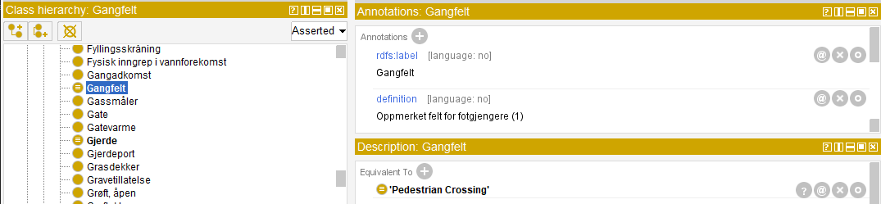
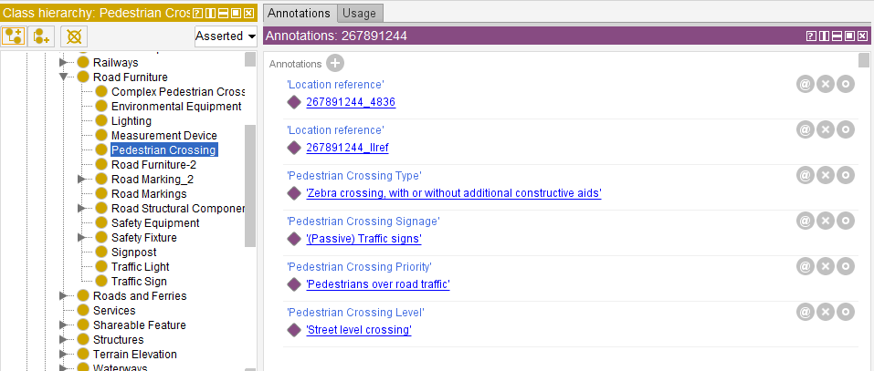
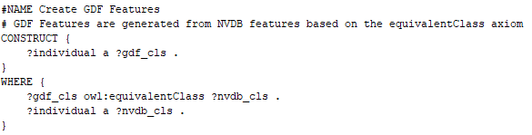
Example LinkSet: NVDB → GDF
NVDB
GDF
SPARQL
Result

Slide 42
Costin, A. and P. Pauwels (2022). Building information modeling and ontologies: overview of shared representations. Research Companion to Building Information Modeling.

Slide 43
Costin, A. and P. Pauwels (2022). Building information modeling and ontologies: overview of shared representations. Research Companion to Building Information Modeling.

